Slide 1
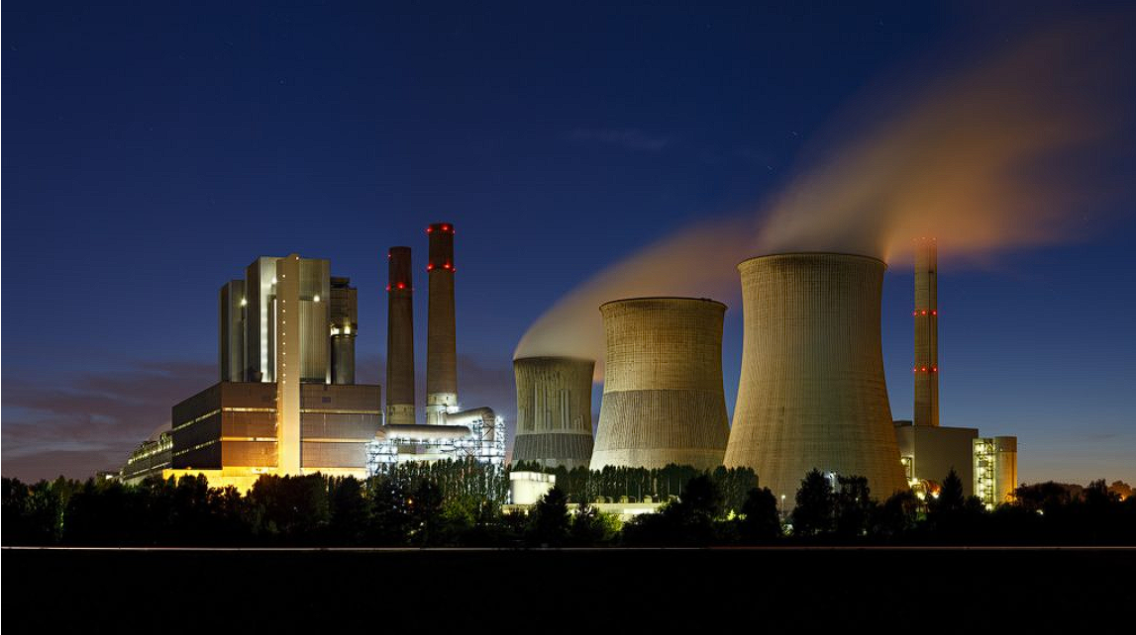
Optimize the power consumption of Zone 1 based on various environmental and meteorological factors in Wellington, New-Zealand using Machine Learning and Deep Learning

Slide 2
Problem Statement The objective is to develop a machine learning model that can predict the power consumption (Zone 1 Power Consumption) of Wellington, New Zealand based on various environmental and meteorological factors. The goal is to create an accurate predictive model that can assist in managing energy resources efficiently and optimizing power consumption in that zone.
Data Dictionary
Sr no.: Serial Number
Temperature: The temperature in Celsius at the specific location.
Humidity: The relative humidity percentage at the location. (g.m-3, i.e. units of grams of water vapor per cubic meter of air. )
Wind Speed: The speed of the wind at the location. (nautical mile per hour )
General Diffuse Flows: Refer to a specific measurement or calculation related to the amount or intensity of diffuse solar radiation in a particular area. (Mtr sqr per sec )
Diffuse Flows: The measure of diffuse solar radiation. (Mtr sqr per sec )
Air Quality Index: An index representing the air quality in the area. (particles in micrograms per cubic meter. )
Cloudiness: The level of cloud cover or cloudiness at the location. (1-Yes,0-No)
Zone 1 Power Consumption: The power consumption in the specific zone, which is the target variable to be predicted. (in KWR- Target value)

Slide 3
Data Cleaning
Steps taken:
We first removed the column ‘S no’ as it was not serving any purpose.
We then renamed our target column ('Power Consumption in A Zone’) to remove an extra space in beginning.
We then converted 3 of our object columns to numerical as they contain numerical values.
We checked for Duplicates but found None.
The missing values were checked for and we found out that less than 1% of the values were missing hence, removed.

Slide 4
EDA
Steps:
Before, doing analysis in detail, we generated an automated EDA report using python sweet viz package.
First, we did Univariate Analysis (Analysis of each Individual features)
We created Box plots for outlier detection, Displots for data distribution.
One of the features ‘Cloudiness’ was also identified as a Categorical feature.
Count plots for Cloudiness feature and Air Quality Index was plotted.
Second, we did Bivariate Analysis (Analysis of any two features with each other.)

Slide 5
Bivariate Analysis
We created Scatter plots for all the numerical features with each other, but could not clearly identify any Correlations.
Then we plotted Heatmap, but did not find any major correlation between features.
VIF was calculated to find the multicollinearity between mildly correlated features.
No major multicollinearity issues were detected.
The bar plots were then plotted with respect to Cloudiness for all the features.
Then we intended to plot the bar chart for all the variables with respect to our target feature ('Power Consumption in A Zone’).
But since all columns were numeric with many unique values, we considered binning.

Slide 6
Statistical Analysis
Statistical analysis was then considered to check the relationship between all our feature and target variable.
We started with checking multicollinearity for all our features using VIF or Variance Inflation Factor (since all are numeric.)
Then we conducted Z-test to check if a given feature has significant impact on target feature.
We observed that for all our features we got a p-value of 0 (<0.05) indicating that they all impact our target feature.
Anova test was then conducted to check if features have statistically significant difference in means when compared to the target variable.
All the p-values for our features came out to be < 0.05 showing that features have statistically significant difference in means when compared with target feature.

Slide 7
Multivariate Analysis and Outlier treatment
We analysed all our feature using Scatter plot with respect to our target feature with respect to Cloudiness and Air Quality Index as these features have the least number of unique numerical values.
We then created pair plots of all the features with respect to each other.
We then proceed to model building and created a baseline Linear Regression model to monitor further model building process.
We created a function to detect outliers, the outliers were then handled to see the effect it will make on our baseline model.
No significant impact was observed.

Slide 8
Model Building
We used these regression models for our task.
KNeighborsRegressor
Linear Regression
SVR (Support Vector Regressor)
Decision Tree Regressor
Random Forest Regressor
XGB Regressor
Lightgbm Regressor
Catboost Regressor

Slide 9
Hyperparameter Tuning and MLP
We then checked the effect of hyperparameter tuning on our model but found no significant impact.
We then tried to train our model using MLP but found the performance to be poor.

Slide 10
PCA
Finally we applied PCA but there was no improvement in the performance.

Slide 11
Conclusion
Finally, Random Forest was found out to be the best model with MAPE of 12%
And R2 score of 62%

